Slide 1
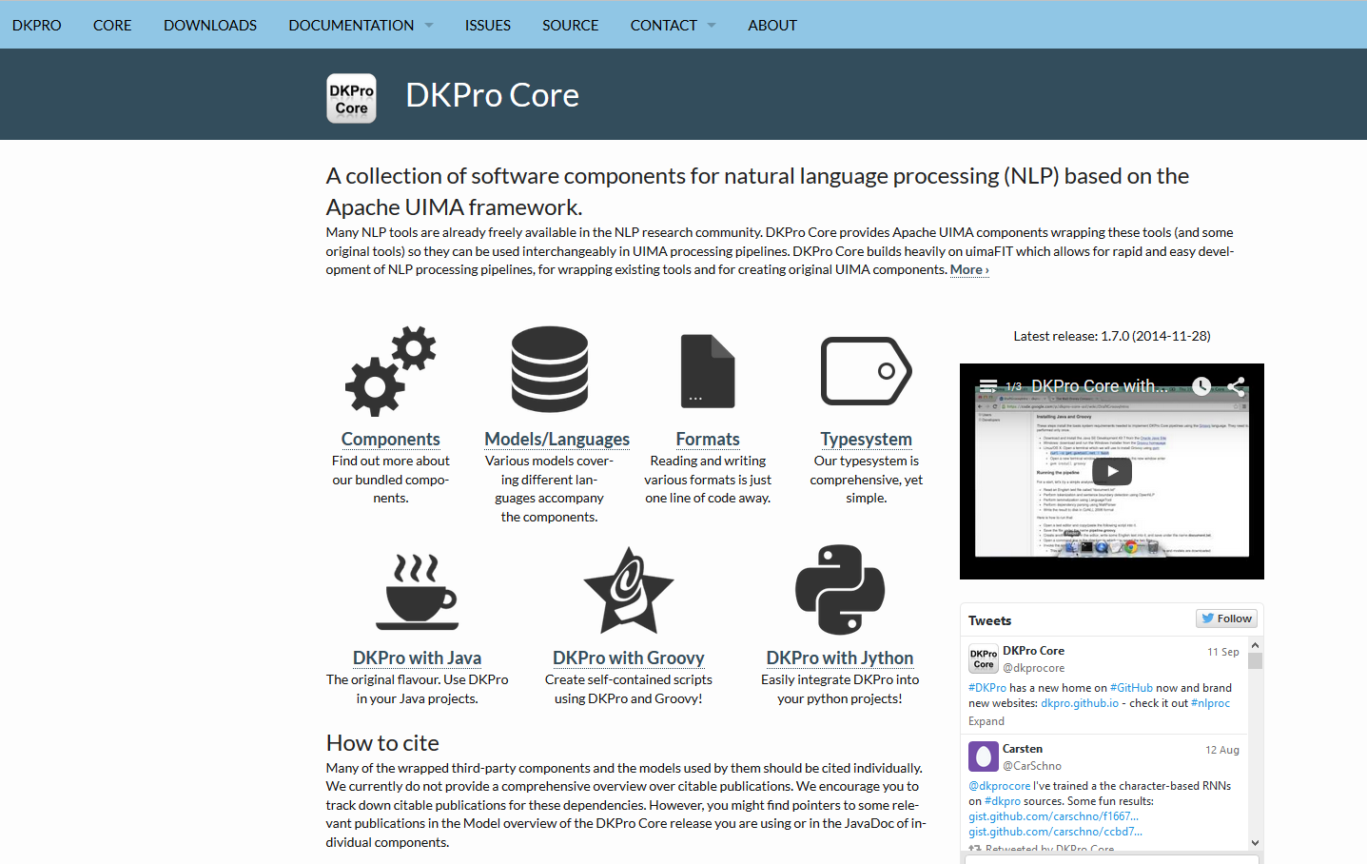

DKPro Core Software components for NLP
M.Sc. Pedro Santos – Ubiquitous Knowledge Processing Lab
Notes:
Colocar figura da página inicial do dkpro core

Slide 2

Agenda
What is a pipeline?
Working with annotations
What is a type system?
What is the Common Analysis Structure (CAS)?
Working with components
What is a reader?
What is an analysis engine?
What is a writer? (aka consumer)
DKPro Core component collection

Slide 3
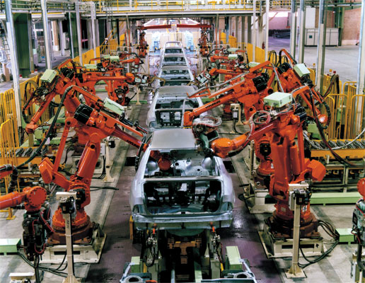
What is UIMA?
Component-based architecture
Analysis of unstructured data
Structure from the unstructured data
How?
Like an assembly line...
Raw material
Refinement, step by step
Nice car in the end

Slide 4
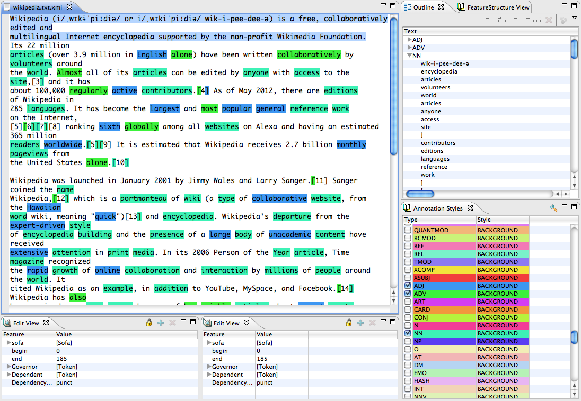
Output Example (UIMA Annotation Editor)

Slide 5

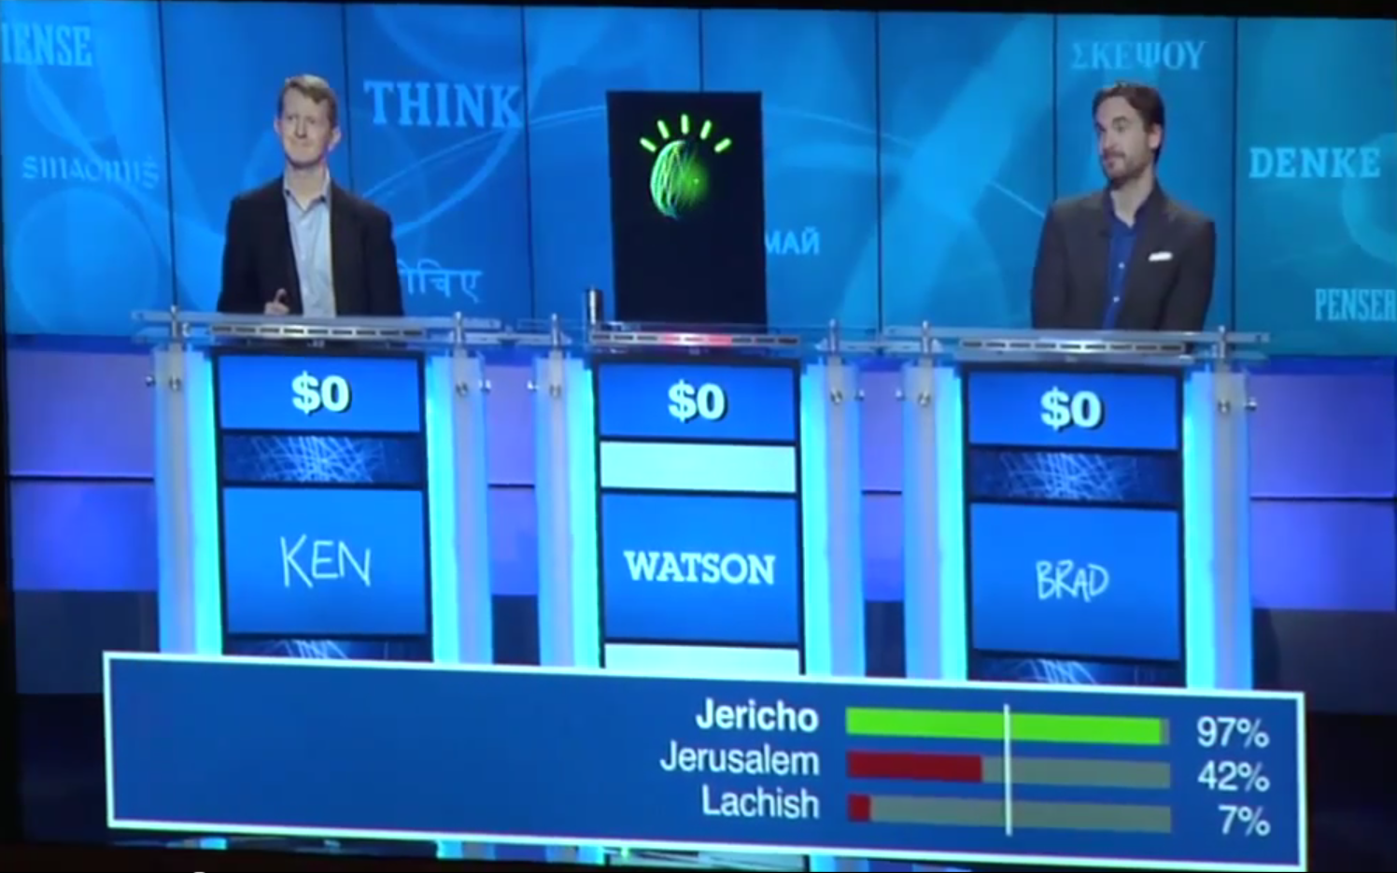
Apache UIMA™ – Some history
2003 – David Ferrucci and Adam Lally paper
Accelerating corporate research in the development, application and deployment of human language technologies
2004 – IBM alphaWorks project
IBM LanguageWare
2006 – Apache Incubator project
2009 – OASIS Standard
2010 – Full Apache project
2010 –IBM’s Watson Jeopardy Challenge
http://uima.apache.org

Slide 6
Pipelines

Slide 7
Pipeline Architecture
abc
abc
abc
abc
abc
Stemmer
Tokenizer
Reader
Lemmatizer
Sentence splitter
Linguistic preprocessing
Compound splitter
Morphological analysis
Stopword tagger
Syntactic analysis
PoS tagger
Named entity tagger
Semantic analysis
Parser
Writer
Datastore / Results

Slide 8
Component – Collection Reader
Empty data structure (CAS) → Reader
Reader → Text (SofA) and Meta-Data (e.g. language)
Reader
CAS
SofA
Language: Latin
DocumentText: Ubi est Cornelia? Subito Marcus vocat: „Ibi Cornelia est, ibi stat!“

Slide 9
Component – Analysis Engine
Structure → Analysis Engine (AE)
Analysis Engine → Annotation
Reader
Tokenizer
Name
Detector
CAS
SofA
Language: Latin
DocumentText: Ubi est Cornelia? Subito Marcus vocat: „Ibi Cornelia est, ibi stat!“
Token(0, 3) Token(4, 7) Token(8,16)...
Name(8, 16) Name(25, 31) ...

Slide 10
CAS Consumer
Annotation -> CAS Consumer
Reader
Tokenizer
Name
Detector
Name
Lister
Word
Counter
CAS
SofA
Cornelia
Marcus
Language: Latin
DocumentText: Ubi est Cornelia? Subito Marcus vocat: „Ibi Cornelia est, ibi stat!“
Token(0, 3) Token(4, 7) Token(8,16)...
Name(8, 16) Name(25, 31) ...
11 words
8 unique words

Slide 11
UIMA Data Structures

Slide 12
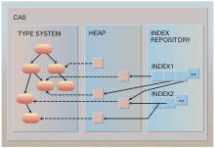
Common Analysis System (CAS)
Access to primary data
Secondary data storage
a.k.a. Annotations
In-memory database
Annotation types = tables
Indexes

Slide 13
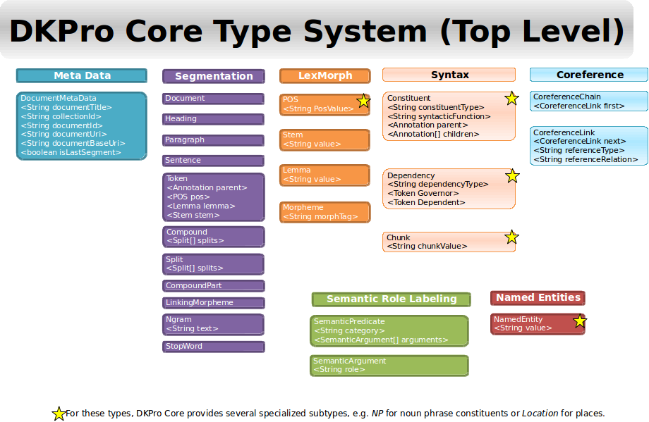
Type System
Platform-independent specification
Object-oriented type system:
Type → class
Feature → class member
Feature Structure -> instance
Single inheritance
Sub-type polymorphism
No methods or encapsulation
Primitive types: integer, float, boolean, string
Built-in complex types: arrays, lists, Annotation
Communication contract

Slide 14


Java + CAS = JCas
JCas = CAS types into the Java type system
JCasGen
Java classes from XML type system descriptor
Token.java – feature structure wrapper with getters and setters
Token_type.java – type wrapper (cf. Java ‘Class’ class)
JCas wrappers cannot be used stand-alone

Slide 15
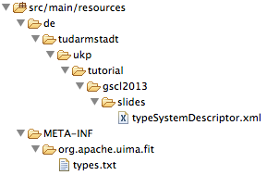
uimaFIT type system detection
No explicit loading/creation of type system
Type system detection mechanism
Types defined in XML descriptor files
Scaning of classpath for type system descriptor files

Slide 16
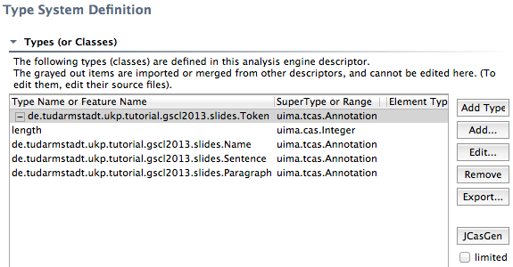
Type System Editor (Eclipse)
JCasGen → UIMA types available as Java Classes

Slide 17
Components

Slide 18
Components
Collection Reader
Analysis Engines
CAS Consumers
Text
Reader
Tokenizer
Name
Detector
Name
Lister
Word
Counter
CAS
SofA
Cornelia
Marcus
Language: Latin
DocumentText: Ubi est Cornelia? Subito Marcus vocat: „Ibi Cornelia est, ibi stat!“
Token(0, 3) Token(4, 7) Token(8,16)...
Name(8, 16) Name(25, 31) ...
11 words
8 unique words

Slide 19

API – Life-Cycle Events
Component life-cycle events
initialize()
reconfigure()
destroy()
Processing life-cycle events
collectionProcessComplete()
batchProcessComplete()
Other
typeSystemInit()

Slide 20

API – Processing Methods
CollectionReader
hasNext()
getNext()
getProgress()
AnalysisEngine
process()
CasConsumer
process()

Slide 21
Figure: Analysis Engine Descriptor
Name
Version
Vendor
Type system
Parameters
Capabilities
Indexes
Resources
Single- / multiple deployment
Delegate Analysis Engines
Flow control
… a few more
Legend
Capability
Name: OpenNlpPosTagger
Version: 1.5.0
Integration of the POS tagger from the OpenNLP project
Parameter
Token
POS
Language

Slide 22
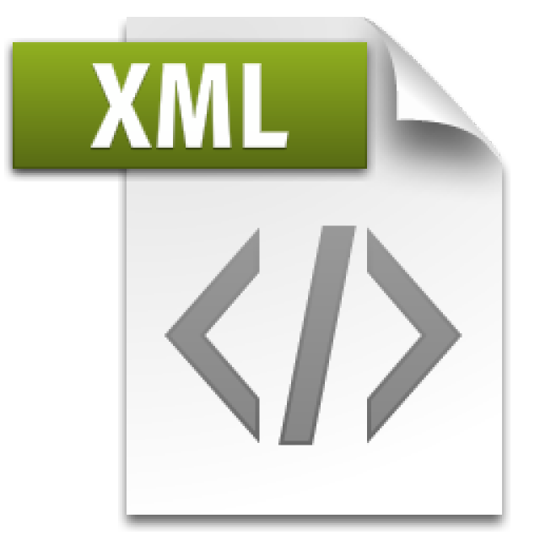
XML Descriptors – Pro & Contra
Pro
“Officially preferred” form of configuration from UIMA components/resources
Widely supported by UIMA tooling
XML elements ↔ Java classes
Contra
Mix declaration/documentation and configuration
Not included when refactoring code
No convenient API (remedy: uimaFIT factories)

Slide 23
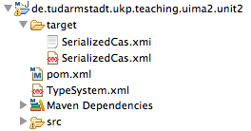
Persisting and loading a CAS
Available serialization formats
XCAS
XML format
XMI
Type-system definition not included!
Tip
Persist type system as “TypeSystem.xml” at project root
Open and XMI file in that project with the CAS Editor

Slide 24
DKPro Core Component Collection

Slide 25
What‘s a component collection
UIMA Framework
UIMA Framework
DKPro Core Component Collection
DKPro Core Component Collection
OpenNLP
OpenNLP
Stanford CoreNLP
Stanford CoreNLP
ClearNLP
ClearNLP
Language Tool
Language Tool
MateTools
MateTools
POS
Tagger
POS
Tagger
Parser
Parser
NER
NER

Slide 26
DKPro Core
Integration framework
Processing: tools and models
Primary data: corpora
Auxiliary data: other language resources (e.g. lexical resources)
Primarily integration of existing work, not original work
Contribution: integration itself
Open Source under Apache Software License & GNU Public License
https://dkpro.github.io/dkpro-core/

Slide 27
DKPro Core Philosophy
Simplicity
Common data types
Common set of parameters
Sensible parameters defaults for minimal need for configuration
Convenient deployment of components and resources
Compose powerful pipelines with a few lines of code
Modularity
Use only what you need
Stuff has to “just work”, everywhere.

Slide 28
DKPro Core Philosophy
Flexibility
Parameters override for fine-grained control
Data types extension with custom fields
Type mappings customization
Stuff has to “just work”, everywhere.

Slide 29






Managing Deployment
DKPro
Repository

Slide 30

UKP OSS Component Repository Publish component

Slide 31


UKP OSS Component Repository Retrieving components
Component
Repository

Slide 32








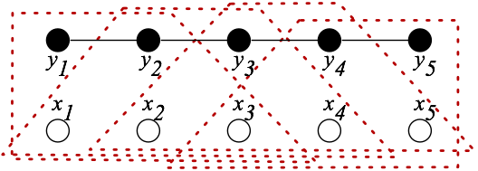
Tools and formats
Integrated tools
Stanford NLP
OpenNLP
Mate-Tools
ClearNLP
LanguageTool
TreeTagger
JWordSplitter
Snowball Stemmer
TextCat
MaltParser
MstParser
BerkeleyParser
…

Slide 33




Tools and formats
Supported formats
Text
PDF
TIGER XML
TEI XML
BNC XML
Negra Export
SQL Databases
Google web1t n-grams
…

Slide 34
Readers and Writers
Common parameters
Source / target location
Source / target encoding
ANT-like patterns (for readers)
Language (for readers)
Common features
Read data from file system, ZIP/JAR archives or classpath
Preserve directory structure on write for recursive reads
abc
abc
abc
abc
abc
Reader
Writer
Datastore / Results

Slide 35

Some currently supported corpora/resources
British National Corpus
Wacky Corpora
TüBa D/Z
Tiger Corpus
Digitale Bibliothek
Brown Corpus
ACL Anthology Reference Corpus
…
Google Web1T n-grams

Slide 36
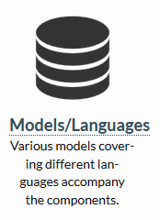
Good range of pre-trained models
Upstream models packaged for convenient deployment and use
Additional model meta-data
90+ models
20+ tools
15+ languages
Best supported
English (Penn Treebank Tagset, Stanford Dependencies)
German (STTS Tagset, Negra/Tiger)

Slide 37
DKPro Type System Overview
Meta Data
Segmentation
LexMorph
DocumentMetaData
<String documentTitle>
<String collectionId>
<String documentId>
<String documentUri>
<String documentBaseUri>
Document
Token
LinkingMorpheme
POS
Heading
Compound
Ngram
Stem
Paragraph
Split
StopWord
Lemma
Sentence
CompoundPart
Morpheme
Syntax
Coreference
Semantic Role Labeling
Annotation
Constitutent
CoreferenceChain
SemanticPredicate
POS
<String posValue>
Dependency
CoreferenceLink
SemanticArgument
Chunk
Named Entities
NamedEntity
Location
N
V
ADJ
CONJ
...
Person
...etc...

Slide 38
Analysis Engines
Common parameters
Model location
Model encoding
Model variant
Mapping location
Language
Common features
Model loading based on document language
Print model tag set to log
Default variants
Document
Analysis Engine
Default
Variant
Mapping
Model
Tagset
Mapping

Slide 39
Hands-on

